Slide 1
Air Quality Insights in U.S. Cities
Noah Mengesha
Notes:
The present research looks at the trends in air quality in big cities in the U.S., by using official monitoring data from the EPA. The analysis addresses three key pollutants respectively: PM2.5, NO2 and O3, all are associated with disease states like respiratory and cardiovascular consequences. The focal city is Washington, D.C, with an urban character and restricted access to data for time series analysis. For static visualizations the research uses Python libraries such as Pandas, Seaborn and Matplotlib, with the possibility of Plotly support for interactivity. Studies of the technical solutions of data storytelling reflect both the short-term variability and long-term trends. The objective is to inform data-based decision making and public awareness.

Slide 2
Project Overview
The dataset includes over 45,000 observations collected by air monitoring stations.
I explored pollutant behavior across multiple dimensions: time, space, and concentration levels.
The analysis supports storytelling through impactful visualizations and structured data exploration.
This study ultimately aims to raise awareness and support data-driven environmental decisions.
Notes:
Urban air pollution is a serious global public health threat because PM2.5 and NO₂ concentrations are often adverse for highly populated places (Gautam et al., 2024). The aim of this project is to understand what these pollutants are doing spatially and temporally across the places. The EPA dataset having more than 45000 data records offers the opportunity for detailed temporal and spatial analysis. In order to find concentrations, outliers, spikes across seasons, air pollutants are measured as an aggregate, as well as city-wide. This method presents the consequential differences based on the way various regions are affected from pollution to one way or the other depending on differences in industrial activities and some meteorological conditions. Lessons learnt from this analysis are also key in learning how to avoid exposure and design localized environmentally corrective measures.

Slide 3
Dataset Description
It contains detailed pollutant measurements including AQI, arithmetic mean values, and maximum hourly values.
Each record corresponds to an observation for a specific pollutant at a given location and time.
The dataset includes pollutants like PM2.5, NO₂, O₃, CO, and SO₂, among others.
With this structure, the data is well-suited for both geographic and time-series analysis.
Notes:
The dataset for this project is sourced from the U.S. Environmental Protection Agency’s air monitoring stations for the year 2021. It includes hourly and daily averages of pollutants, as well as metadata on city, state, coordinates, measurement method, and observation count. Among the main pollutants studied are PM2.5, NO₂, O₃, and others, which were selected based on their prevalence and effects on public health. PM2.5 is fine dust that enters and penetrates the lung, NO₂ is a traffic pollutant; while O₃ is formed from a chemical reaction initiated by sunlight (Li et al 2023). A photograph of the behavior of pollutant versus space and time are produced for each data record. This holistic framework enables adequate assessment of quality of air in urban areas.

Slide 4
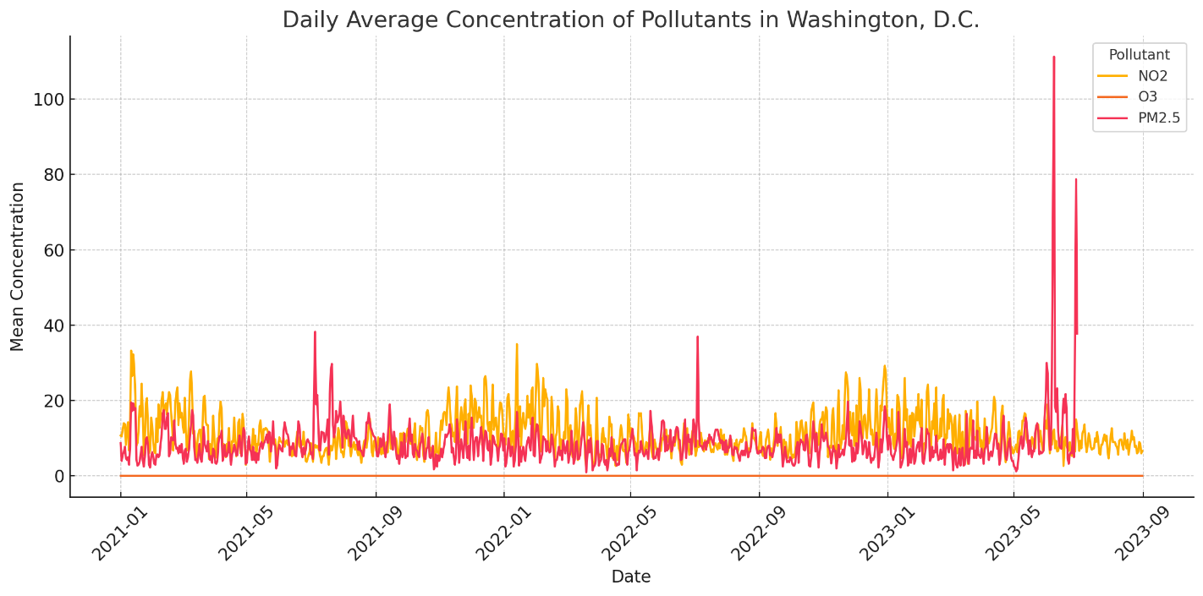
Daily Trend in Washington, D.C.
Notes:
Washington, D.C., can be used as a case study to illustrate the dietary pattern in relation to daily air quality using time series analysis. The data observations appear to reveal a certain trend, with PM2.5 and NO₂ both exhibiting sharp peaks that are largely associated with colder months and peak traffic days. O₃ variation has smoothed seasonal patterns and has increased during warm conditions, which implies enhanced photochemical activity. Such seasonal trends are closely related to investigations that point to the fact that sunlight and temperature are the key factors in ozone production (Sharma et al., 2024). Heating and congestion are major causes of pollutant variation in urban dynamics. Your attention to this time series chart will reveal the need to monitor the year for effective air quality control.

Slide 5
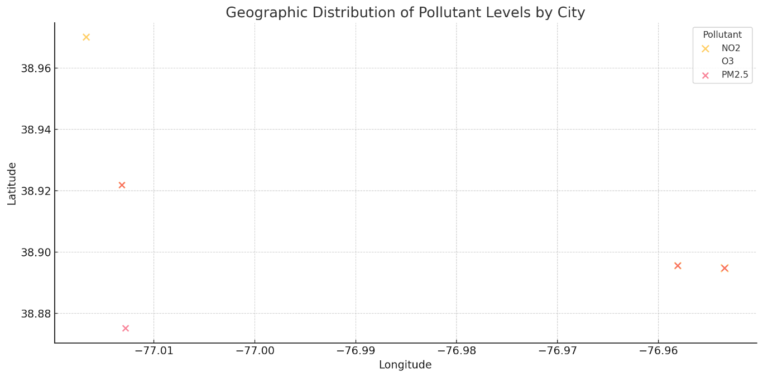
Geographic Distribution
This geographic view reveals how different pollutants are distributed across the country.
It also emphasizes the spatial disparity in air quality and the need for regional policy action.
The visualization makes it easier to target air pollution mitigation strategies by location.
Notes:
Spatial distribution maps show the concentration differences of pollutants among U.S. cities. The data indicate that people in areas characterized as large urban centers with high vehicular and industrial activities have high levels of PM2.5 and NO₂. In contrast, O₃ is more evenly distributed but is still geographically and climatically affected. These findings align with other worldwide studies that correlate urban form with meteorology and pollution hotspots (Zhang et al., 2022). The geographic analysis enables stakeholders to learn about areas with chronic respiratory health problems. Such maps facilitate the scheduling of public health interventions and zoning regulations.

Slide 6
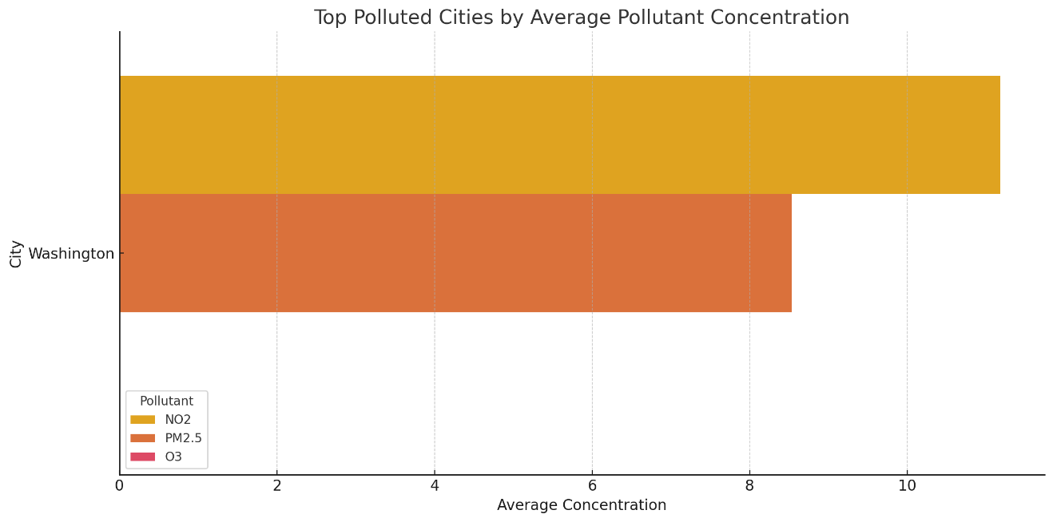
Top Polluted Cities
Notes:
A comparative bar chart illustrates the leading cities that experience the highest mean concentrations of PM2.5, NO₂, and O₃. Thick,, heavily trafficked urban areas, often deprived of vegetation, exhibit significant PM2.5 and NO₂ values. O₃ concentrations are highest in urban areas where high levels of sunlight are experienced, confirming the secondary nature of this contaminant. These results align with recent studies that identify the role of urban morphology and climate in determining pollutant profiles (Gautam et al., 2024). The cities that perform the worst also provide a focus for mitigation strategies. Such a comparison also depicts several pollution triggers in different urban areas.

Slide 7

Pollutant Trends (Static Time Series)
PM2.5 and NO₂ often spike on specific days, possibly due to traffic or weather changes.
O₃ displays a smoother curve that aligns with its secondary nature as a pollutant.
The visualization is useful for monitoring trends and preparing for air quality alerts.
It demonstrates the value of consistent and granular pollutant monitoring over time.
Notes:
The static visualization of time series supports the findings for Washington, D.C., providing additional information about how pollutant levels vary according to the seasons. Alternatively, an interactive visualization was attempted, but the static chart remains effective in visualizing peaks in time and patterns. PM2.5 and NO₂ exhibit short-term spikes, which are typically attributed to various human activities, such as heating and traffic. In contrast, the cyclical responses related to seasonal photochemical processes are more subdued in the case of O₃ (Li et al., 2023). Such implications underscore the importance of tracking time in an environmental context. The chart is a strong basis for early-warning systems and regulatory policies.

Slide 8
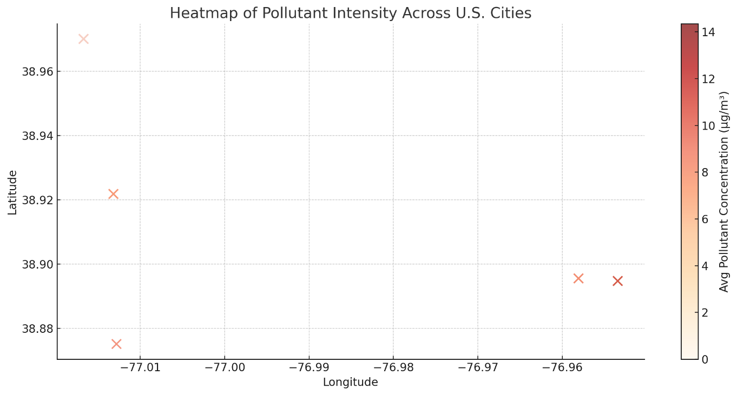
Pollution Intensity Heatmap
This map is valuable for understanding spatial pollution distribution at a national scale.
It can also support environmental justice advocacy by identifying high-risk areas.
The visual summary provides intuitive insight into which cities need immediate attention.
Notes:
A heatmap is a two-dimensional presentation of U.S. cities where pollution intensity is mapped using color coded point markers. Polluted cities, which are associated with intensive infrastructure and industrial activity, with the level of pollution associated with known sources, are categorized by groups of higher concentrations. Spatial gradient identifies variability of exposure and vulnerability. Such perception is logical, considering the research findings that there is heightened propensity to risk in low-income and high density community (Zhang et al., 2022). This visualization may be useful by focusing on environmental justice initiatives. It can be used by policymakers to distribute resources and track performance in terms of clean air in under served areas.

Slide 9
Conclusion & Next Steps
This analysis shows that PM2.5 and NO₂ concentrations are closely tied to urban and traffic-related activity.
O₃ concentrations show more seasonal and geographic dependence based on temperature and sunlight.
The project successfully used data storytelling techniques to reveal trends and geographic patterns.
Findings can be used by environmental researchers, urban planners, and public health officials.
Future work could include multi-year comparisons and predictive modeling using machine learning.
Expanding the dataset and introducing real-time monitoring dashboards would enhance public engagement.
Notes:
This research recommends that human activity, weather pattern and geography are factors that heighten the complexity of the urban air pollution. PM2.5 and NO₂ are very closely linked to urban traffic and heating systems; O₃ is directly associated with climatic and photochemical variations. This project offers a composite view of the urban air quality using both the static and spatial analysis. Future work should also widen the dataset using a few years of captured data and also have dashboards for real-time monitoring. The prediction of high-risk occurrences can also be estimated on the basis of the Machine learning options. These following steps shall assist in obtaining predictability and the public involvement in air quality management.

Slide 10
References
Gautam, M., Singh, K., Gautam, A. S., & Gautam, S. (2024). Longitudinal study of air pollutants in Indian metropolises: Seasonal patterns and urban variability. Aerosol Science and Engineering. https://link.springer.com/article/10.1007/s41810-024-00262-4
Li, J., Yu, S., Zhang, Y., & Wang, Y. (2023). Seasonal dynamics and sources of urban ozone in North America. Environmental Research Letters, 18(1), 014004. https://doi.org/10.1088/1748-9326/acb5d6
Zhang, H., Chen, Y., & Liu, X. (2022). Urban morphology and spatial inequality in exposure to air pollutants. Nature Communications, 13(1), 1249. https://www.nature.com/articles/s41467-022-28971-5

